Slide 1


NG WEI YI
20th SEPTEMBER 2022

Slide 2

Outline
Executive Summary
Introduction
Methodology
Results
Conclusion
Appendix

Slide 3
Executive Summary
Summary of methodologies
Data collection using SpaceX API and web scraping
Data wrangling
Exploratory Data Analysis (EDA) with SQL and visualization
Interactive visual analytics with Folium
Machine learning prediction
Summary of all results
Exploratory Data Analysis (EDA) result
Machine learning prediction result

Slide 4
Introduction
Project background and context
SpaceX advertises Falcon 9 rocket launches on its website with a cost of 62 million dollars; other providers cost upward of 165 million dollars each, much of the savings is because SpaceX can reuse the first stage. Therefore if we can determine if the first stage will land, we can determine the cost of a launch. This information can be used by an alternate company to bid against SpaceX for a rocket launch.
Problems you want to find answers
- Which factors determine the success or failure of a rocket landing?
What are the effects of each relationship of the rocket variables on the outcome?
Conditions that aid SpaceX to achieve highest rocket landing success rate.

Slide 5

Section 1

Slide 6
Methodology
Executive Summary
Data collection methodology:
SpaceX REST API
Web scraping from Wikipedia
Perform data wrangling
Dropping irrelevant columns
Applied one hot encoding to categorical variables
Perform exploratory data analysis (EDA) using visualization and SQL
Perform interactive visual analytics using Folium and Plotly Dash
Perform predictive analysis using classification models
How to build, tune, evaluate classification models

Slide 7
Data Collection
Data sets are collected using SpaceX REST API and web scraping from Wikipedia
Data sets collected using SpaceX REST API (https://api.spacexdata.com/v4/)
Data sets collected by web scraping from Wikipedia (https://en.wikipedia.org/wiki/List_of_Falcon\_9\_and_Falcon_Heavy_launches)
SpaceX REST API call
API returns JSON file
Create dataframe using the JSON file
Clean the data and export it as CSV
Get HTML request from Wikipedia
Extract data with BeautifulSoup
Create dataframe
Export the dataframe as CSV

Slide 8
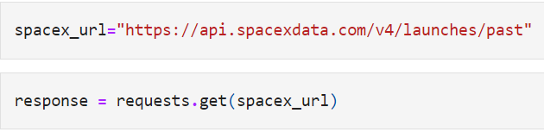
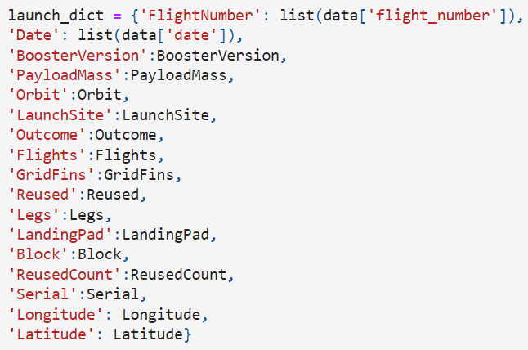
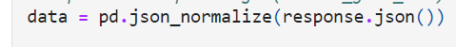
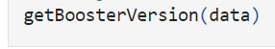
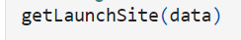
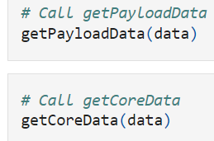
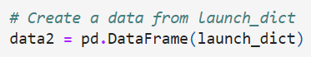
Data Collection – SpaceX API
1. Getting response from API
4. Combine the data and columns into a dictionary
6. Filter dataframe
2. Convert response to JSON file
3. Extract data from JSON file
7. Export dataframe as CSV file
5. Create dataframe

Slide 9
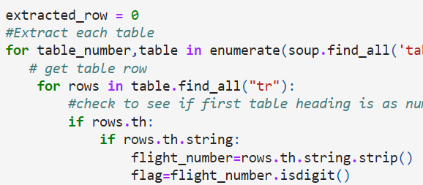
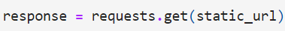
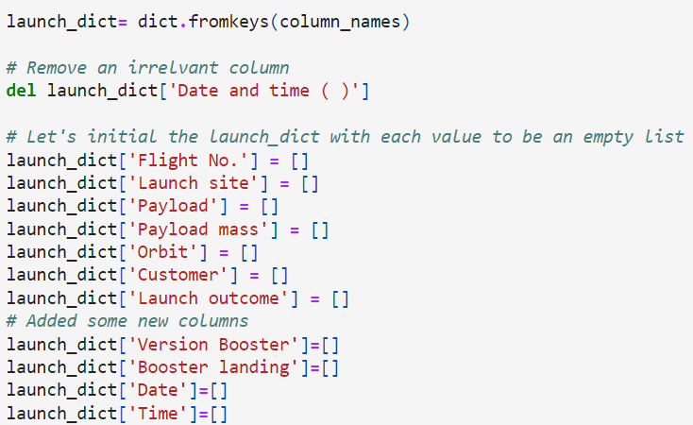
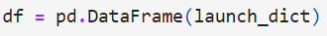
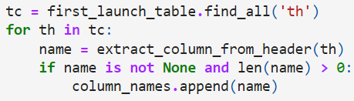
Data Collection - Scraping
1. Getting response from HTML
6. Add data to keys
5. Create dictionary
2. Create BeautifulSoup object
3. Find all tables
7. Create a dataframe from dictionary
4. Get column names
8. Export dataframe as CSV file

Slide 10
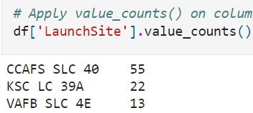
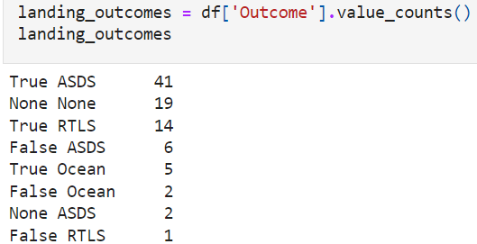
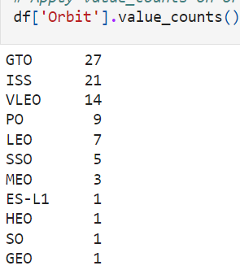
Data Wrangling
Data wrangling is the process of removing errors and clean the data to make them more accessible and less complex to analyze.
The outcomes of rocket landing are divided into two categories:
True Ocean, True RTLS, True ASDS mean a successful landing (denoted as 1).
False Ocean, False RTLS, False ASDS mean a failure landing (denoted as 0).
1. Calculate the total count for each site
4. Convert all the outcomes into two categorical values, 1 and 0
3. Calculate the total count for each type
Of outcome
2. Calculate the total count for
each orbit type
5. Convert the dataframe to CSV file

Slide 11



EDA with Data Visualization
Three different charts are used to visualize the data: scatter, bar, and line charts.
Scatter Chart
Line Chart
Bar Chart
Flight Number vs. Payload Mass
Flight Number vs. Launch Site
Payload Mass vs. Launch Site
Orbit vs. Flight Number
Payload Mass vs. Orbit
Success Rate vs. Year
Success Rate vs. Orbit

Slide 12
EDA with SQL
SQL queries are performed to extract and understand major information about the data set. Queries performed are shown below:
Display the names of the unique launch sites in the space mission
Display 5 records where launch sites begin with the string 'CCA’
Display the total payload mass carried by boosters launched by NASA (CRS)
Display average payload mass carried by booster version F9 v1.1
List the date when the first successful landing outcome in ground pad was achieved
List the names of the boosters which have success in drone ship and have payload mass greater than 4000 but less than 6000
List the total number of successful and failure mission outcomes
List the names of the booster versions which have carried the maximum payload mass
List the failed landing_outcomes in drone ship, their booster versions, and launch site names for in year 2015
Rank the count of landing outcomes (such as Failure (drone ship) or Success (ground pad)) between the date 2010-06-04 and 2017-03-20, in descending order

Slide 13
Build an Interactive Map with Folium
One of the factors that affect the launch success rate is location. Hence, finding the optimal location for building a launch site is important.
An interactive map can be built using Folium in Python:
A Folium Map object is created with initial center location to be NASA Johnson Space Center at Houston, Texas.
Red circle at NASA Johnson Space Center’s coordinates with a label showing the name (folium.Circle, folium.map.Marker)
Red circle at each launch site’s coordinates with a label showing the name (folium.Circle, folium.map.Marker, folium.features.DivIcon)
Success and failure launches for each site are marked, MarkerCluster object is used to simplify a map containing many markers having the same coordinate (folium.plugins.MarkerCluster)
Two colors are used for the outcome of rocket landing, Green is used for successful landing whereas Red is for failed landing (folium.map.Marker, folium.Icon)
The distances between launch sites and key locations (railway, highway, city) and a line is plotted between them (folium.map.Marker, folium.PolyLine, folium.features.DivIcon)

Slide 14
Build a Dashboard with Plotly Dash
The dashboard built has dropdown to choose a site or all sites, pie chart, scatter plot, and range slider:
The Dropdown feature allows user to choose a site or all sites (dash.dcc.Dropdown)
Pie chart shows the total success and failure rate for a launch site using the Dropdown feature (plotly.express.pie)
Scatter plot shows the user the relationship between success rate and payload mass (plotly.express.scatter)
Range slider allows a user to select a specific range of payload mass for the scatter plot (dash.dcc.RangeSlider)

Slide 15
Predictive Analysis (Classification)
The flowchart below shows the model development process:
Data preparation by loading data then standardize them
The data is then split into training and test sets
GridSearchCV is used to find the best parameters using the training set.
A machine learning algorithm is selected.
The algorithm with the highest accuracy is chosen.
Steps 3 to 6 are repeated for other algorithms.
Confusion matrix is plotted
The algorithm is performed on the test set and accuracy is computed

Slide 16
Results
Exploratory data analysis results
Interactive analytics demo in screenshots
Predictive analysis results

Slide 17

Section 2

Slide 18
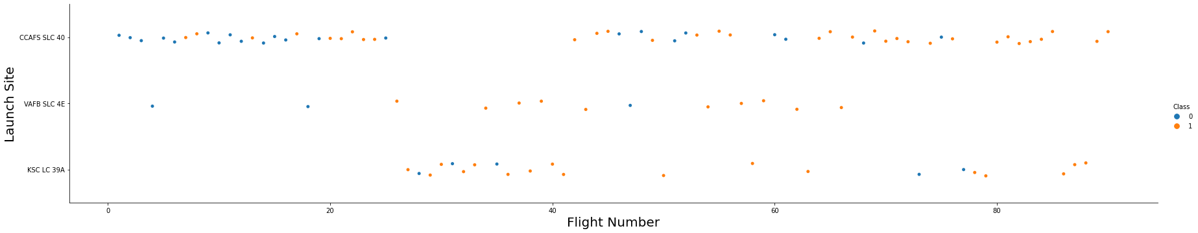
Flight Number vs. Launch Site
We can observe that the success rate is increasing for each site.

Slide 19
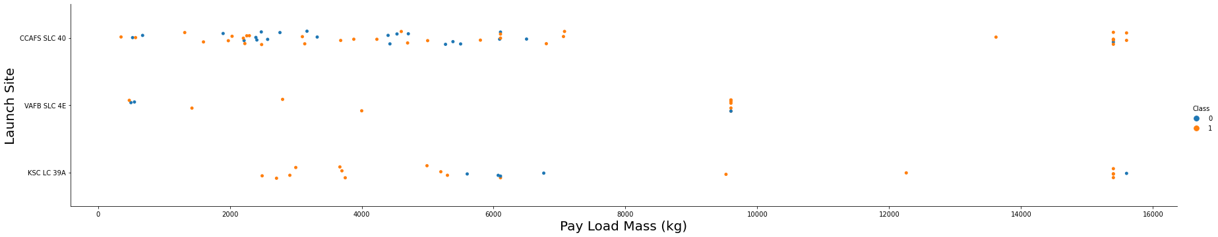
Payload vs. Launch Site
Heavier payloads seem to be having higher success rate as compared to lighter payloads. However, this depends on launch site.

Slide 20
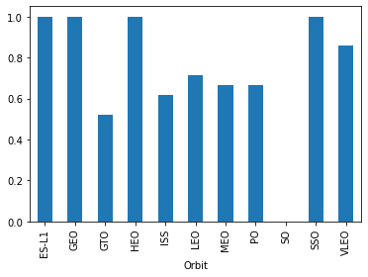
Success Rate vs. Orbit Type
ES-L1, GEO, HEO, and SSO orbit types have higher success rate as compared to other orbit types.

Slide 21
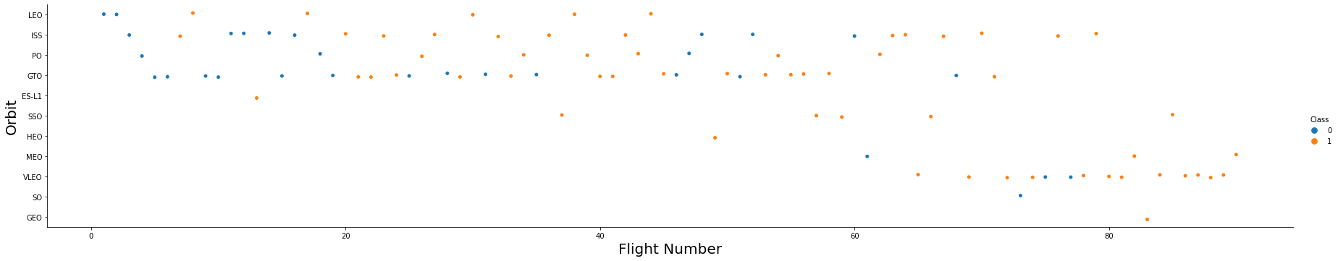
Flight Number vs. Orbit Type
In general, the success rate has been improved with increasing flight number.
The obvious case is that the success rate increases with flight number for the VLEO orbit type.

Slide 22
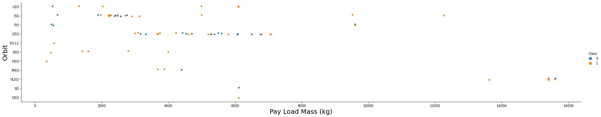
Payload vs. Orbit Type
The success rate of the launches has been greatly influenced by the weight of payloads in certain orbit types. For example, heavier payloads have higher success rate for VLEO and ISS orbit types.

Slide 23
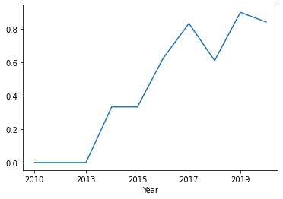
Launch Success Yearly Trend
The success rate has been increasing every year as shown in the line chart.

Slide 24
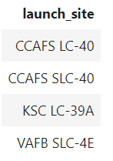
All Launch Site Names
DISTINCT is used in the query to show unique launch sites from the data.

Slide 25
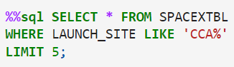
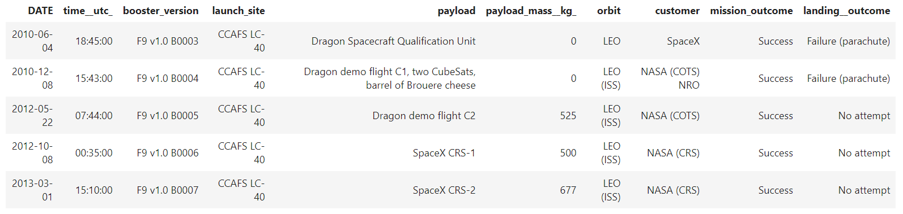
Launch Site Names Begin with 'CCA'
The WHERE and LIKE clauses are used to filter launch sites that contain the substring ‘CCA’ and the query limits to only 5 records.

Slide 26
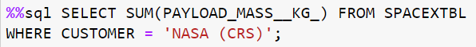
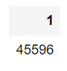
Total Payload Mass
SUM() function is used to calculate the sum of all payload masses where the customer is NASA (CRS).

Slide 27
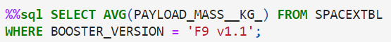
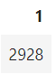
Average Payload Mass by F9 v1.1
The AVG() function is used to calculate the average of all payload masses where the booster version is F9 v1.1.

Slide 28
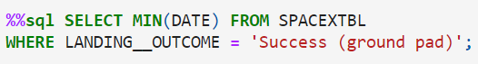
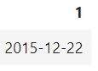
First Successful Ground Landing Date
The MIN() function here is used to find the earliest date where the landing outcome of ground pad is successful.

Slide 29
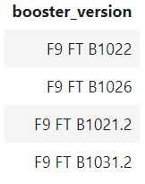
Successful Drone Ship Landing with Payload between 4000 and 6000
The WHERE and AND clauses are used to filter the landing outcomes which have successfully landed on a drone ship and having the payload mass between 4000 KG and 6000 KG.

Slide 30
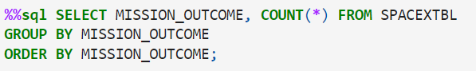
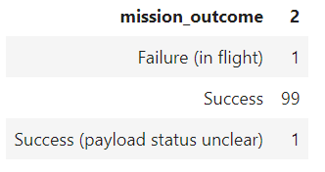
Total Number of Successful and Failure Mission Outcomes
The COUNT() function counts the number of rows in the data and by grouping the mission outcomes, there are in total of 100 successful outcomes and 1 failed outcome.

Slide 31
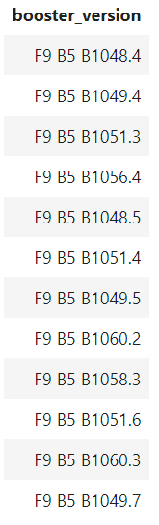
Boosters Carried Maximum Payload
A subquery is used to find the booster versions that have the maximum payload mass from the data.

Slide 32
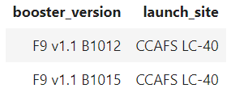
2015 Launch Records
The WHERE and AND clauses are used to filter the booster version and launch site having landing outcomes which have failed to land on a drone ship and it happened in the year 2015.

Slide 33
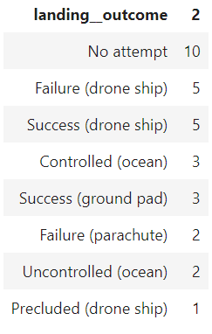
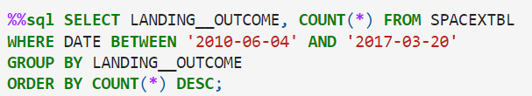
Rank Landing Outcomes Between 2010-06-04 and 2017-03-20
The COUNT() function is used to count the total number of rows and the WHERE clause is used to filter the date set between 2010-06-04 and 2017-03-20. The query is then grouped by the landing outcome using GROUP BY clause and the ORDER BY clause is used to order the grouped landing outcome in descending order.

Slide 34

Section 3

Slide 35
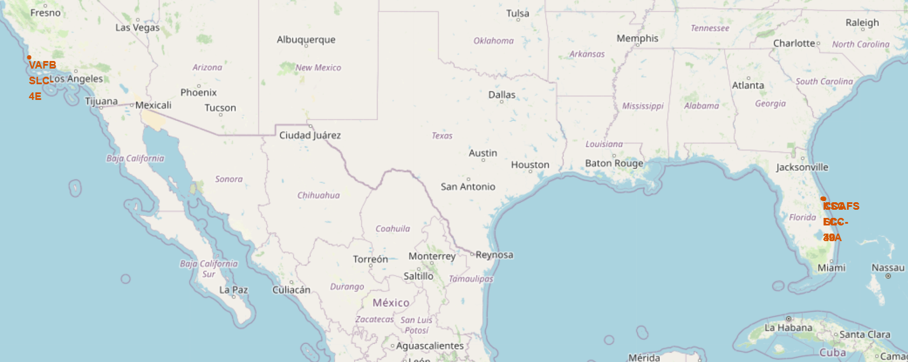
All Launch Sites on Folium Map
Based on the screenshot shown above, the launch sites are located on the coasts of USA.

Slide 36
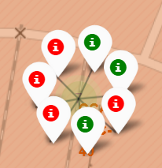
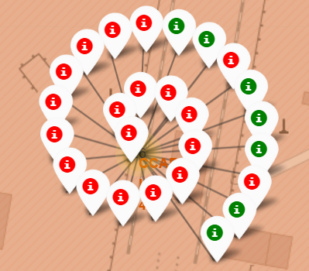
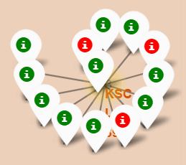
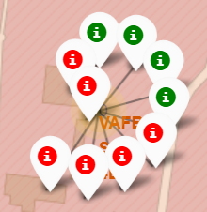
Color Labeled Markers on Folium Map
The Green markers indicate successful launches whereas Red markers indicate failed launches in each site on the map.

Slide 37
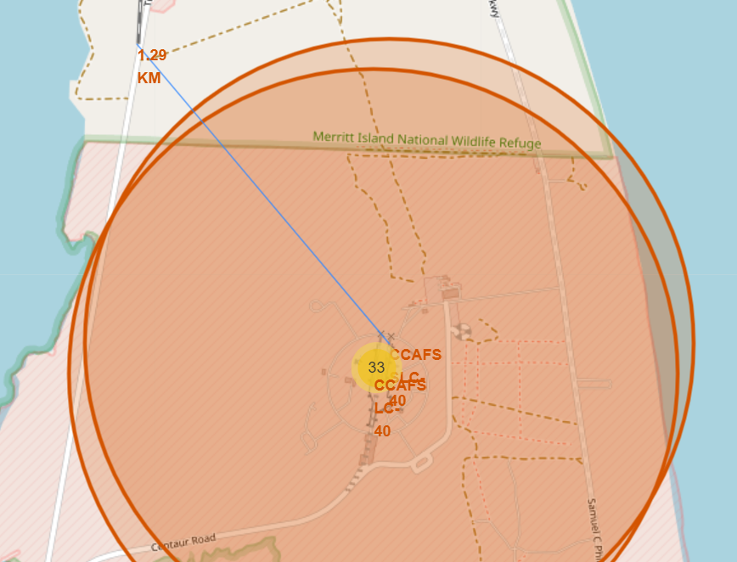
Distance of Launch Site to Other Locations
The screenshot shows the distance between one of the sites, CCAFS SLC-40 to the nearest railway, which is about 1.29 KM away.

Slide 38

Section 4

Slide 39
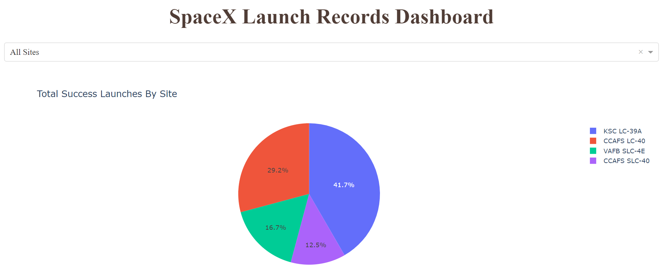
Successful Launches by All Sites
We can clearly see that KSC LC-39A has the most successful launches out of all the sites, 41.7%.

Slide 40
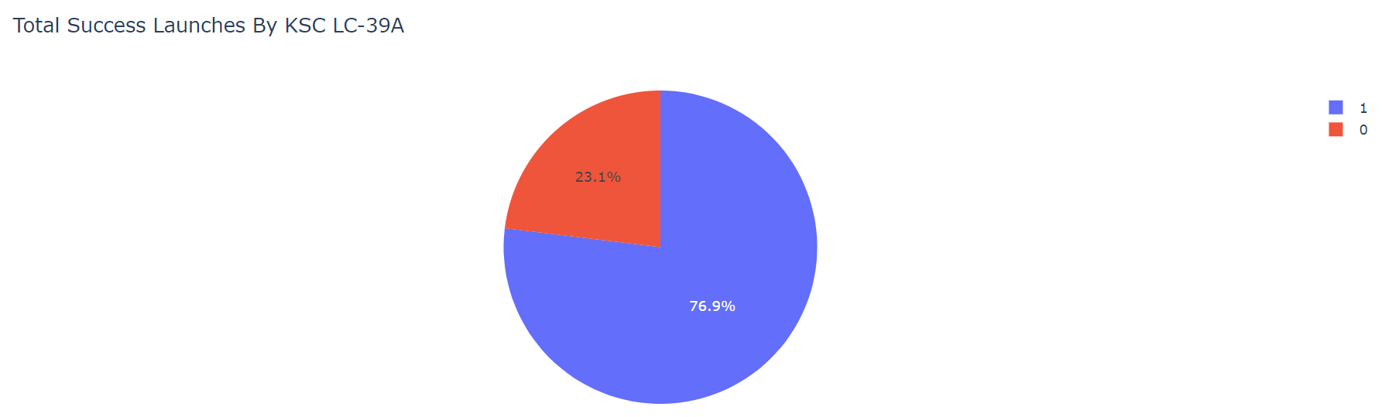
Launch Success ratio for KSC LC-39A
KSC LC-39A has a 76.9% success rate and a 23.1% failure rate.

Slide 41
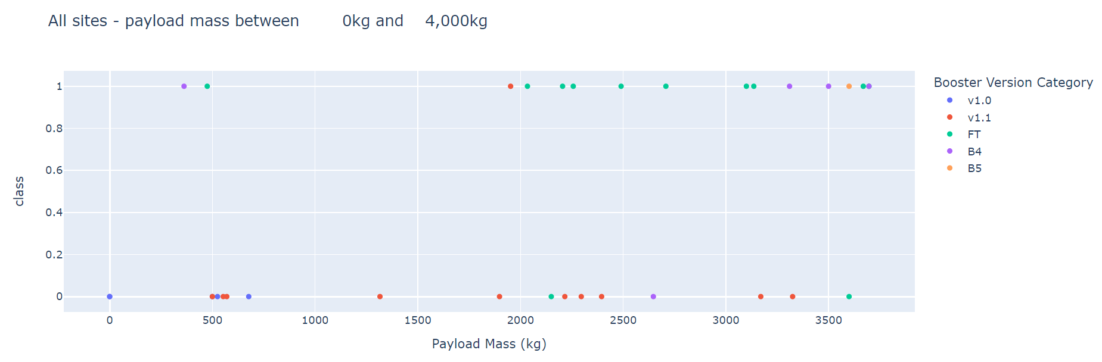
Low Payload Mass vs. Launch Outcome Scatter Plot for All Sites
Low weighted payloads have higher success rate.

Slide 42
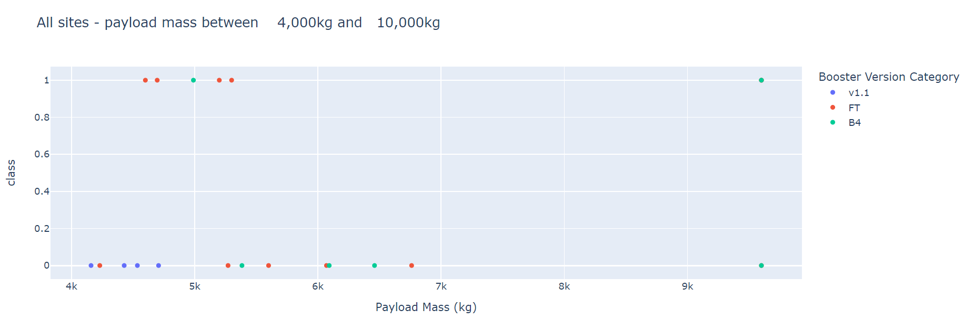
High Payload Mass vs. Launch Outcome Scatter Plot for All Sites
High weighted payloads have lower success rate.

Slide 43

Section 5

Slide 44
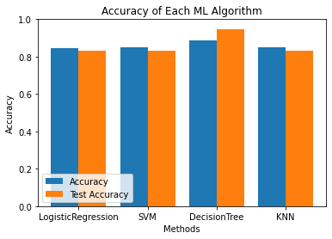
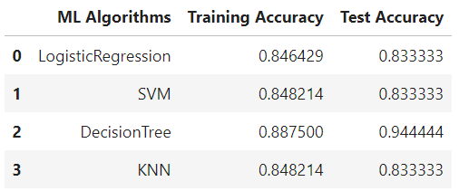
Classification Accuracy
Based on the bar chart and the table, it is clear that the best model with the highest accuracy is Decision Tree Classifier, 89.0% training accuracy and 94.0% test accuracy. The best parameters of this classifier is shown below.

Slide 45
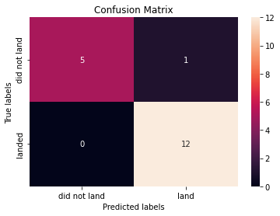
Confusion Matrix
The confusion matrix of Decision Tree Classifier is shown here.
Only one sample has been misclassified by the algorithm.
This shows that there is a big number of true positive and true negative as compared to false positive and false negative.

Slide 46
Conclusions
The success rate increases with an increased in flight number.
KSC LC-39A has the most successful launches of any site.
ES-L1, GEO, HEO, and SSO orbit types have higher success rate.
The launch success rate has been increasing throughout the years from 2013 to 2020.
Decision Tree Classifier can be used to predict the outcome of a landing and increase the profit.

Slide 47


